Slide 1

Covid-19 Data Visualization
Dataset: “Conditions Contributing to COVID-19 Deaths, by State and Age, Provisional 2020-2023”
Notes:
1

Slide 2
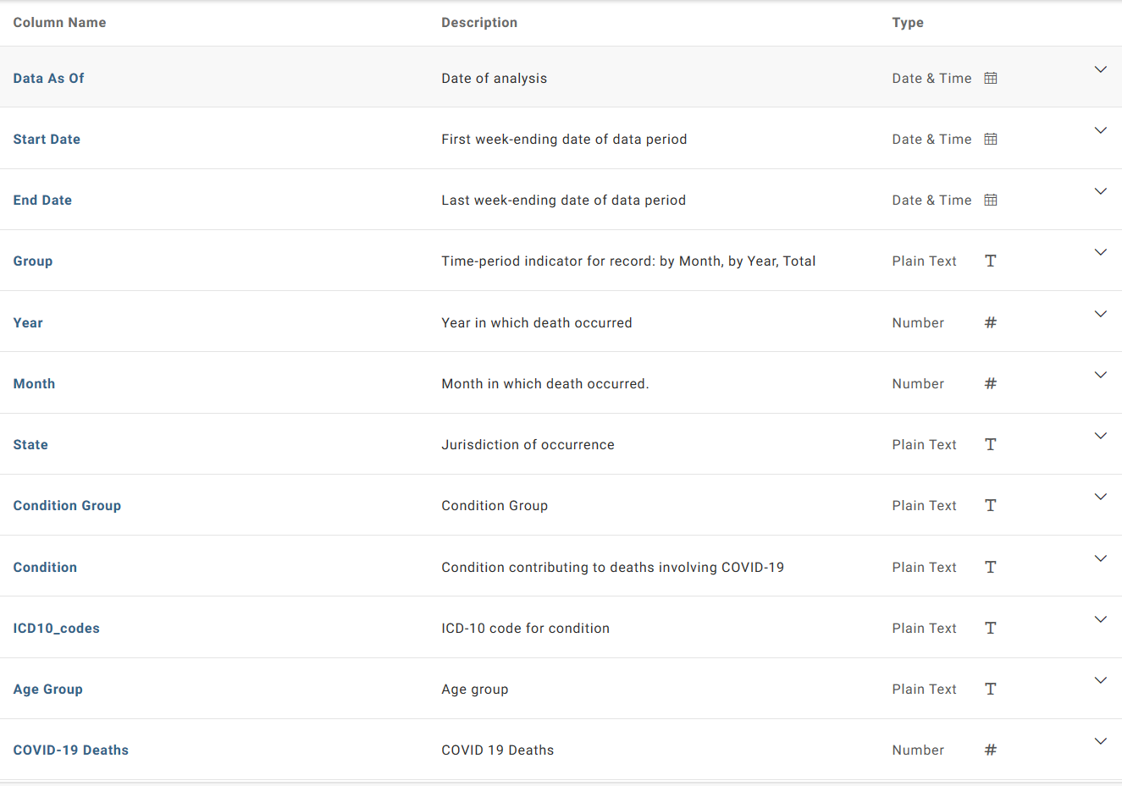
Field Names -
Notes:
2

Slide 3
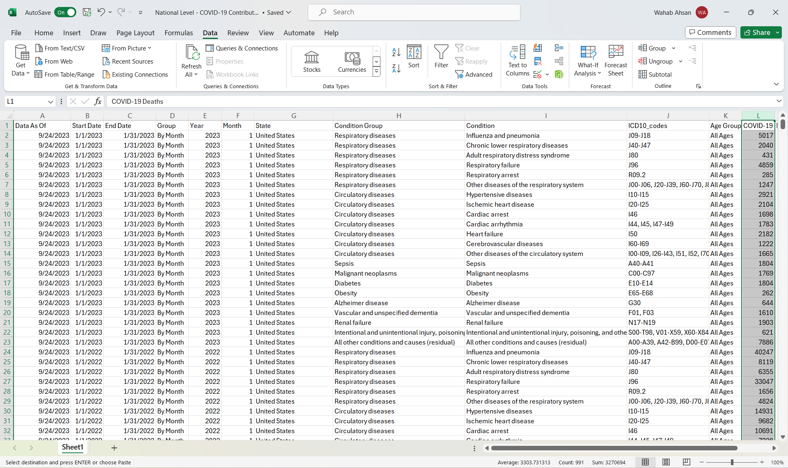
Filtered by month, at the U.S. level, and all ages
Notes:
3

Slide 4
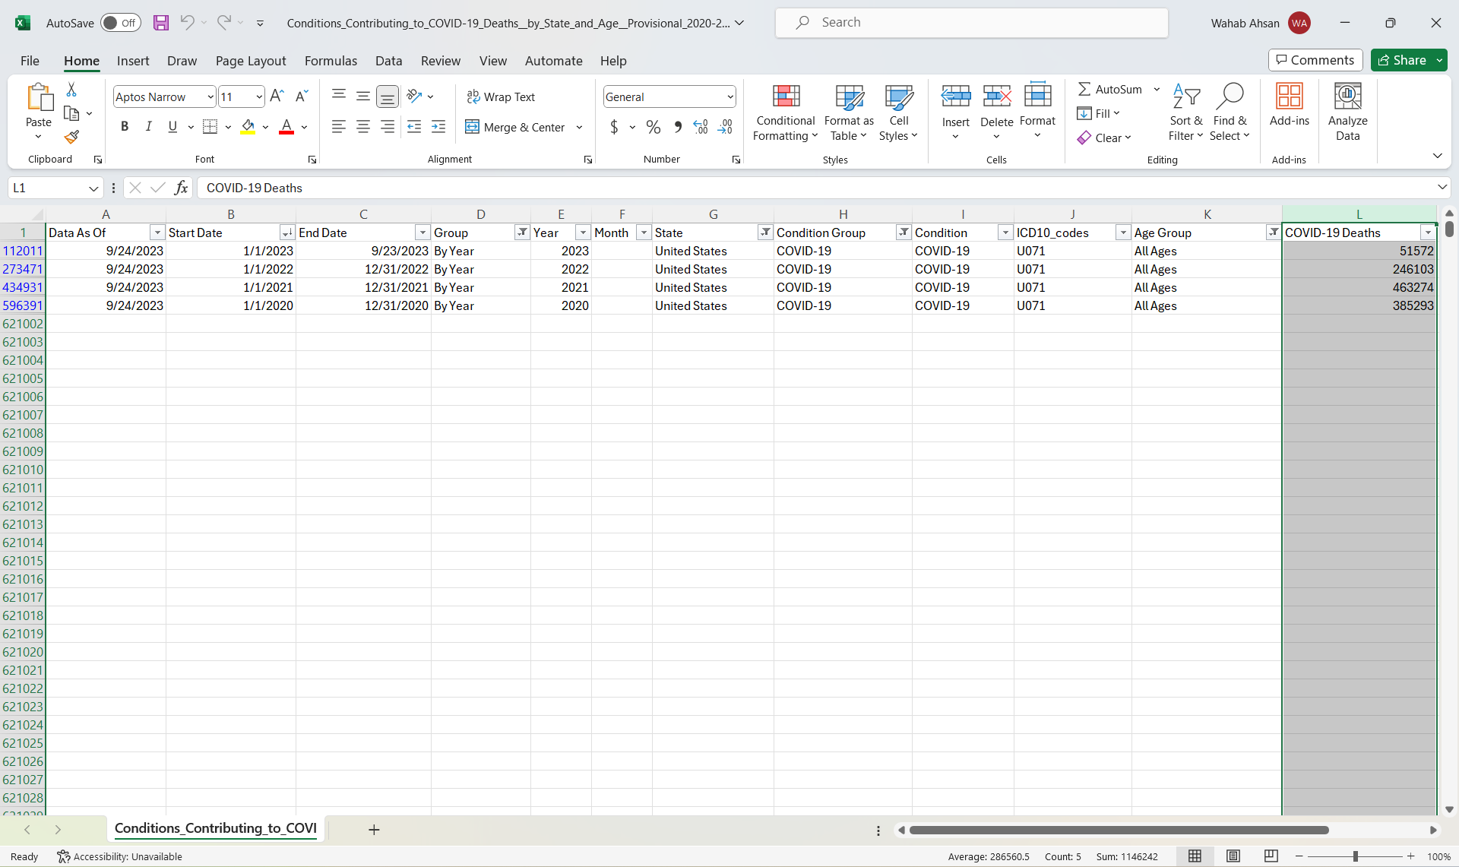
Total Number of Deaths in the U.S. from Covid-19 alone Each Year
Notes:
4

Slide 5
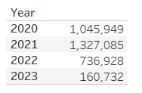
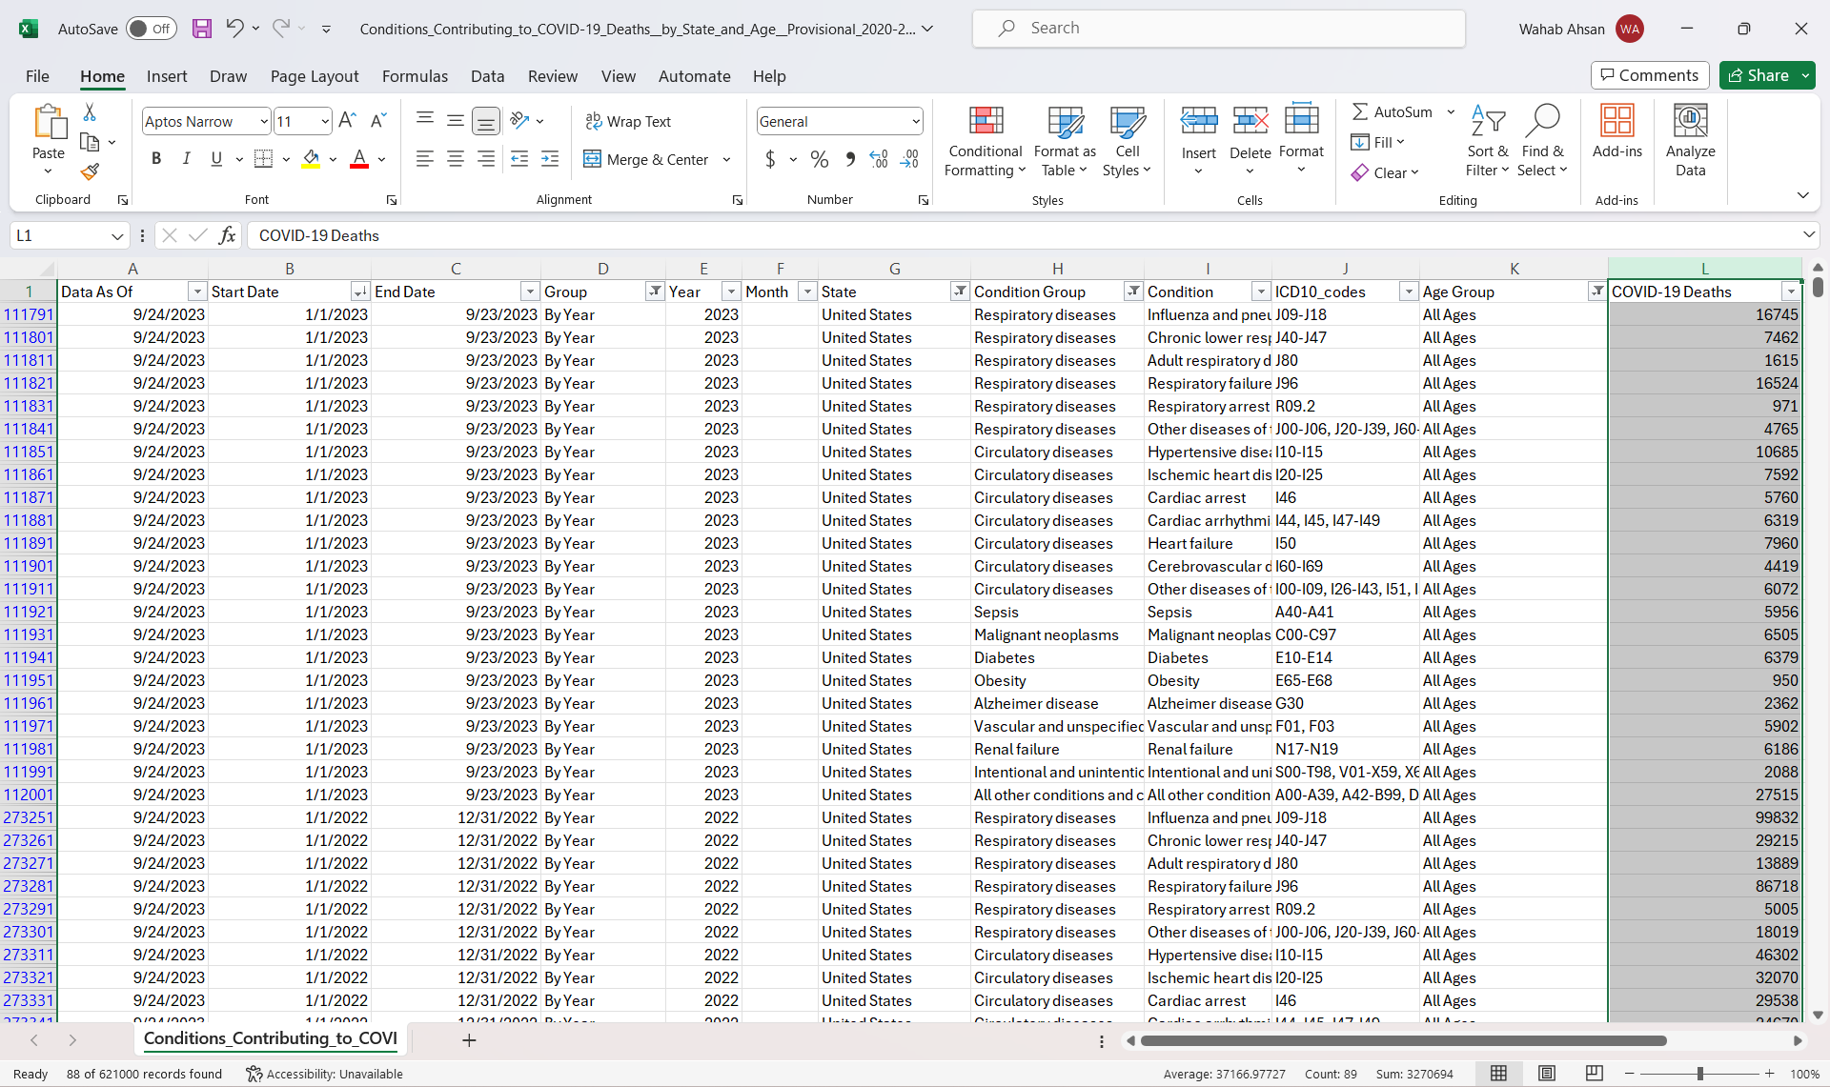
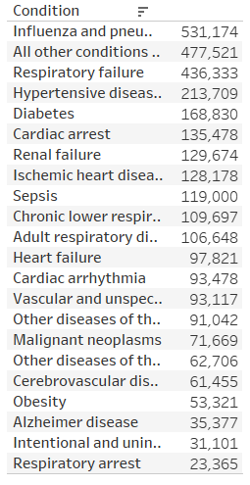
Total Number of Deaths in the U.S. from Diseases Contributing to Covid-19 By Year
Notes:
5

Slide 6
Tableau Demonstration - Filtered at the state level by month
Notes:
6

Slide 7
Tableau Demonstration - Filter includes age groups
Notes:
7

